Slide 1
TRAFFIC LIGHT MANAGEMENT SYSTEM
Submitted by
Vimal Kumar(2014ucp1312)
Vicky Anand(2014ucp1325)
Aditya Bhavsar(2014ucp1225)

Slide 2
OBJECTIVE
Traffic Congestion
Inefficient Traffic Flow
Sophisticated control and co-ordination
Surveillance System

Slide 3

TRAFFIC SIGNALS

Slide 4
GOALS
Increase Transportation System Efficiency
Enhance Mobility
Improve Safety
Reduce Fuel Consumption

Slide 5
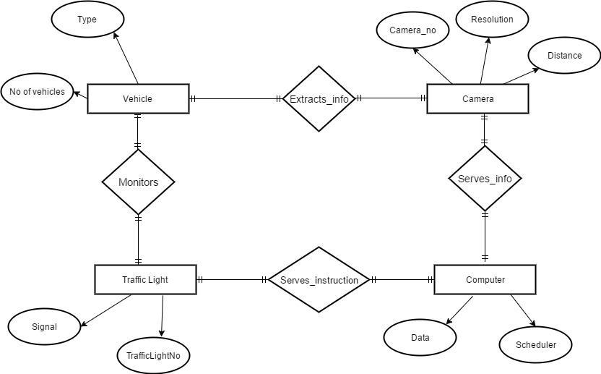
ER Diagram

Slide 6
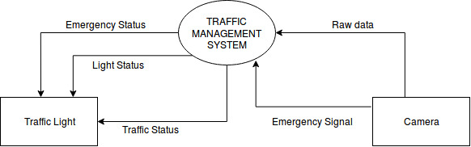
DFD Level0

Slide 7
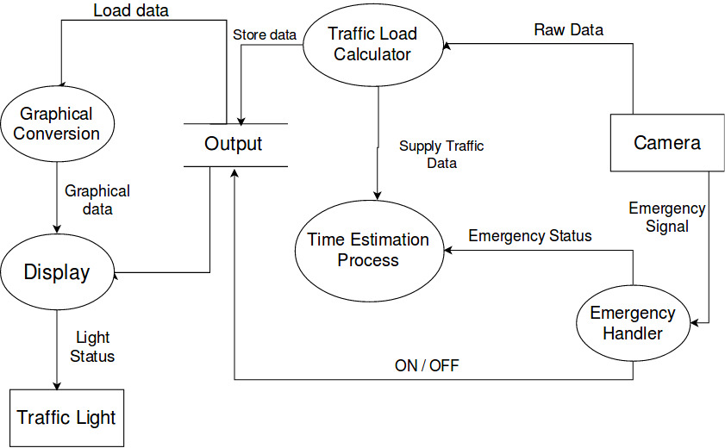
DFD Level1

Slide 8
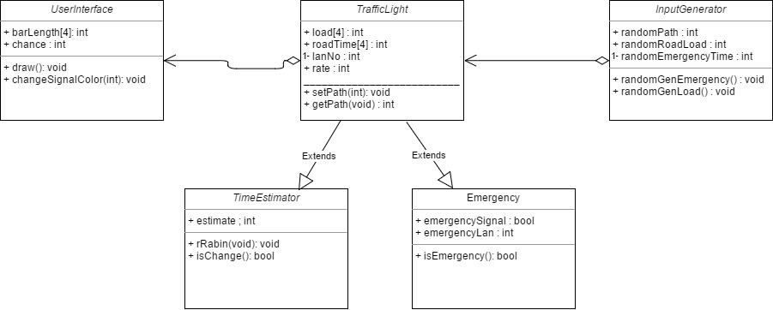
Class Diagram

Slide 9
THANK YOU

